Slide 1
Further
Spend every day wisely

Slide 2



VEBA
2 | Proprietary + Confidential

Slide 3







Your Voluntary Employee Beneficiary
Association (VEBA) account
A health care expense management account that you own
Open and funded, tax-free by your employer
You pay no taxes on interest earned or on funds you take out to pay for qualified medical expenses
No “use it or lose it” rule – unused money
rolls over and continues to accumulate
Pay medical expenses
now or in the future and health insurance premiums when you retire
3 | Proprietary + Confidential

Slide 4










How your VEBA works
Works
with any employer-sponsored medical health plan
Your employer
funds the account;
the money belongs to you
No taxes
on money going in, interest earned or on qualified withdrawals
Unused money
rolls over to save for future medical expenses
Convenient Further debit card to pay providers for eligible expenses
Use it to pay for:
Pair with an HSA¹ or an FSA for added flexibility and increased savings
Mutual Fund investment options are available²
Qualified health care expenses
Health insurance premiums like COBRA or Medicare
Some long-term care premiums
¹ VEBA dollars will be limited toward eligible dental and vision expenses until individuals meet their medical health plan deductibles.
² Once your Base Balance exceeds $1,000 you can open a Basic Investment Account and invest in more than 30 mutual funds with Charles Schwab.

Slide 5





You can use a VEBA to pay for:
These you can’t pay for:
NEW! Over-the-counter supplies, medications, and some feminine hygiene products
Out-of-pocket expenses until you reach your deductible
Health insurance premiums like COBRA during a job transition or Medicare in retirement
Other medical expenses and insurance premiums during retirement
Premiums for some long-term care insurance
Medical expenses not covered by your health plan, including:
Current health insurance premiums while you’re employed
Costs that aren’t considered
qualified medical expenses as
defined by the IRS
Always save your receipts to ensure proper validation
of expenses, as required by the IRS.
Co-payments
Co-insurance
Prescription drugs
Dental care expenses
Vision care expenses

Slide 6



Meet the Millers
Empty nesters
Bill, a teacher for 28 years: $48,000/yr.
Emily, freelance web designer: $34,000/yr.
 | Without a VEBA | With a VEBA
Employer annual VEBA contribution | $0 | $900
Health care expenses for the year | $500 | $500
VEBA account | $0 | $500
Remaining balance carried forward | $0 | $400
Balance after five years¹ | $0 | $2,000
STRATEGY:
Maximize savings with a VEBA
Earn tax-free investment returns
Pair with an FSA for current expenses
Pair with an HSA and limit to dental and vision expenses, or freeze VEBA for retirement
GOALS:
Retire in five years
Preserve retirement accounts
(401k and IRA) for travel
Plan for medical expenses not
covered by Medicare
Pay for future health plan premiums
6 | Proprietary + Confidential
¹Does not include any interest or investment earnings that may be earned on balances.
The Miller’s story is a hypothetical example for purposes of illustration only

Slide 7

Combine VEBA
Pairing with an HSA
If paired with an HSA, the VEBA will be limited to permitted benefits such as vision and dental care benefits until the health plan deductible is met.
Pairing a VEBA with an HSA and/or FSA increases the spending and savings power for members
Pairing with an FSA
If paired with an FSA, eligible expenses will be reimbursed from the Medical FSA until the account has been exhausted. Only then will eligible expenses be reimbursed from the VEBA account
Pairing with an HSA and FSA
Combining the benefits of the VEBA, HSA, and FSA allows members to maximize tax-advantaged medical spending and savings.

Slide 8


Use this page if audience appropriate – or delete
Paired with an HSA – VEBA limited
 | VEBA | HSA
Employer annual VEBA contribution | $900 | $900
Your pre-tax² HSA contribution | $0 | $1,200
Health care expenses: medical $500 and dental and vision $400 | $400 | $500
Account balances after expenses – year one | $500 | $1,600
Account balances after five years¹ | $2,500 | $8,000
Tax savings with HSA contributions² – year one | $0 | $360
Tax savings with HSA over five-year period | $0 | $1,800
¹ Does not include any interest or investment earnings that may be earned on balances.
² Assumes a 30% tax bracket. Actual tax savings will depend on HSA contributions, applicable state tax rates and personal tax situation.
Please consult your tax adviser for details.
This is a hypothetical example for purposes of illustration only..
8 | Proprietary + Confidential

Slide 9
Use this page if audience appropriate – or delete
Paired with an HSA – VEBA frozen
 | VEBA | HSA
Employer annual VEBA contribution | $900 | $900
Your pre-tax² HSA contribution | $0 | $1,200
Health care expenses: medical $500 and dental and vision $400 | $0 | $900
Account balances after expenses – year one | $900 | $1,200
Account balances after five years¹ | $4,500 | $6,000
Tax savings with HSA contributions² – year one | $0 | $360
Tax savings with HSA over five-year period | $0 | $1,800
¹ Does not include any interest or investment earnings that may be earned on balances.
² Assumes a 30% tax bracket. Actual tax savings will depend on HSA contributions, applicable state tax rates and personal tax situation.
Please consult your tax adviser for details.
This is a hypothetical example for purposes of illustration only..
9 | Proprietary + Confidential

Slide 10
Use this page if audience appropriate – or delete
A VEBA paired with an FSA
 | VEBA | FSA
Employer annual VEBA contribution | $900 | $0
Your pre-tax¹ FSA contribution | $0 | $900
Health care expenses: medical $500 and dental and vision $400 | $0 | $900
Account balances after expenses – year one | $900 | $0
VEBA balance after five years² | $4,500 | $0
¹ Tax savings may vary based on your tax filing status. See your tax advisor for details.
² Does not include any interest or investment earnings that may be earned on balances.
This is a hypothetical example for purposes of illustration only..
10 | Proprietary + Confidential

Slide 11


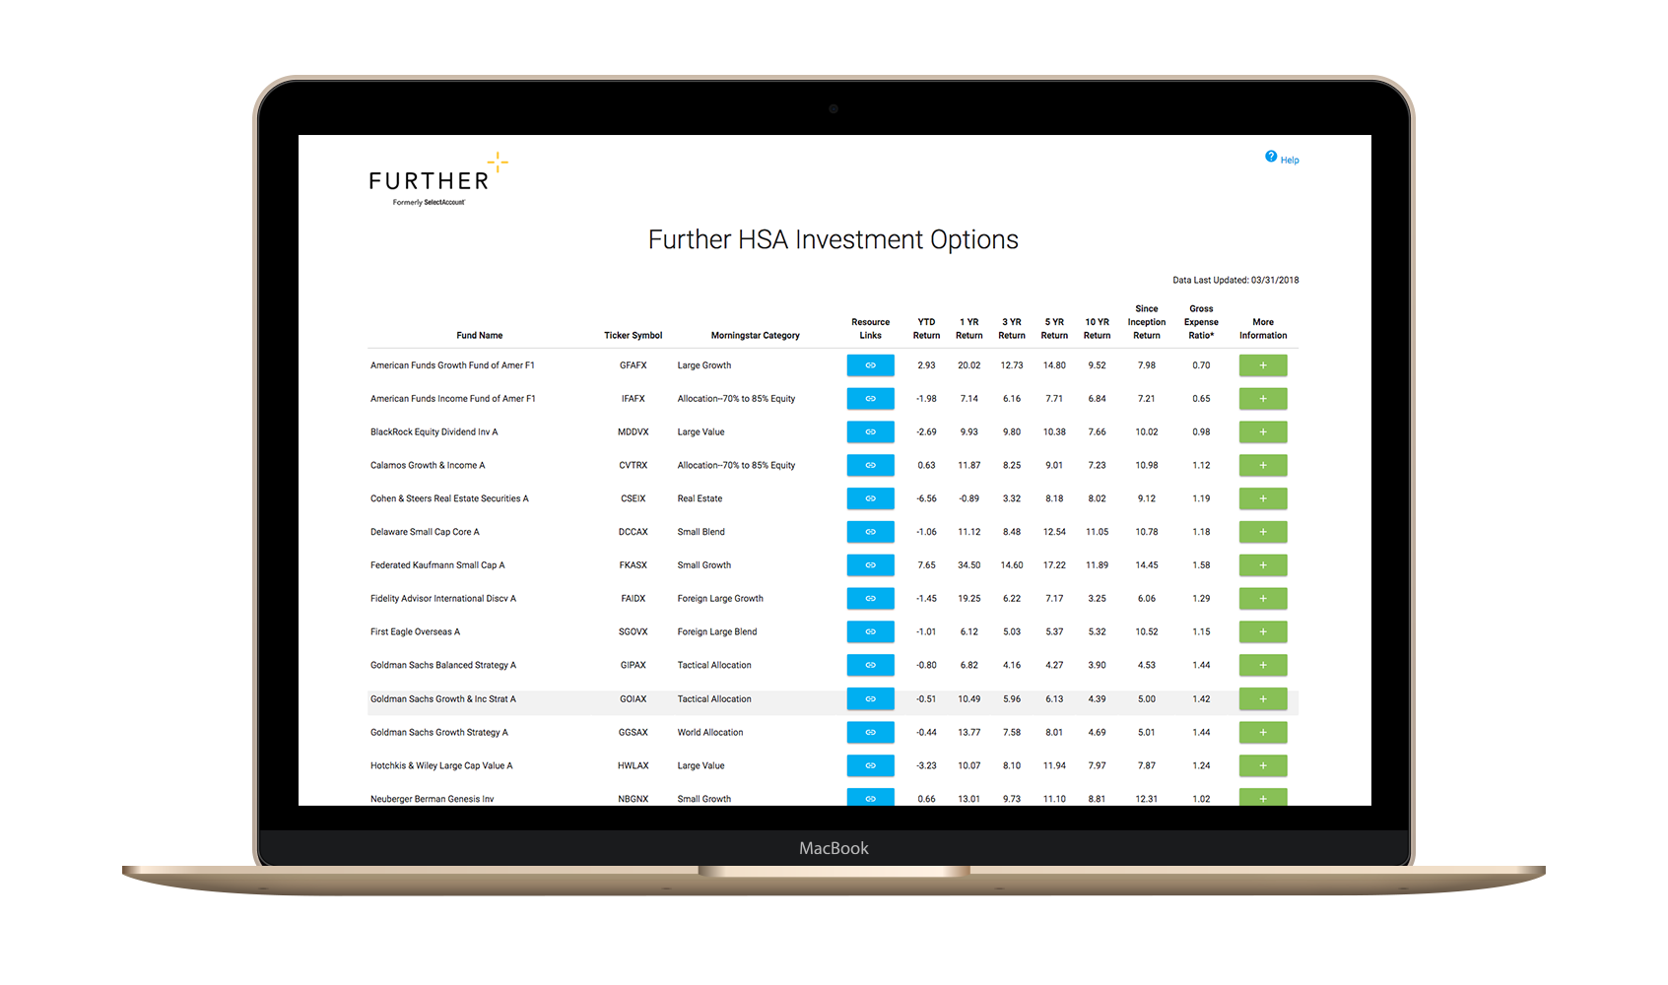
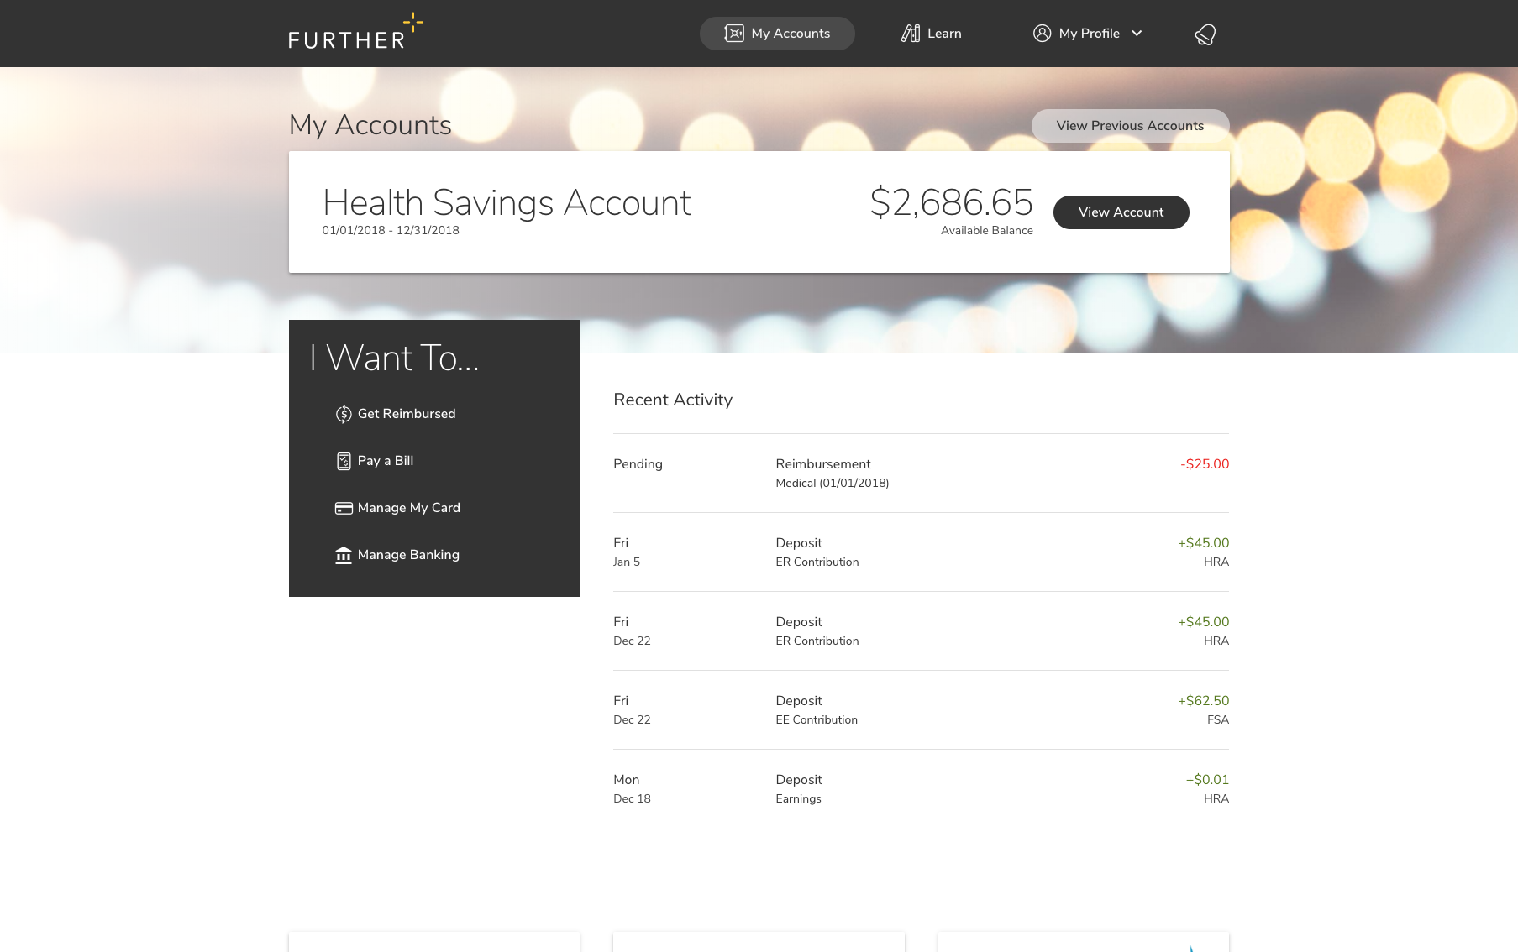
After you’re enrolled
Receive your Spending Account I.D. and Visa® debit card by mail
Register on hellofurther.com
Download mobile app
Pay providers with your Visa® debit card or submit claims for reimbursement
View account activity and check balances
Download forms and upload receipts
View and manage investments
Request additional Visa® debit cards
Manage beneficiaries
Notes:
To be used for VEBA PowerPoints

Slide 12

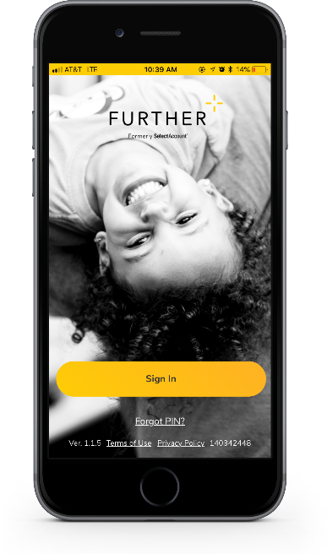

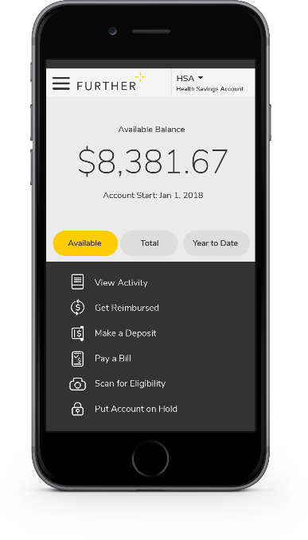

Mobile App
Easy to use tool that features:
  Fingerprint and facial ID unlock
  Snap and save document photos
  Barcode scanner to check eligibility
  Mobile access to all primary actions
  View activity
  Pay bills
  Make deposits
  Get reimbursed
Text options for account activities

Slide 13


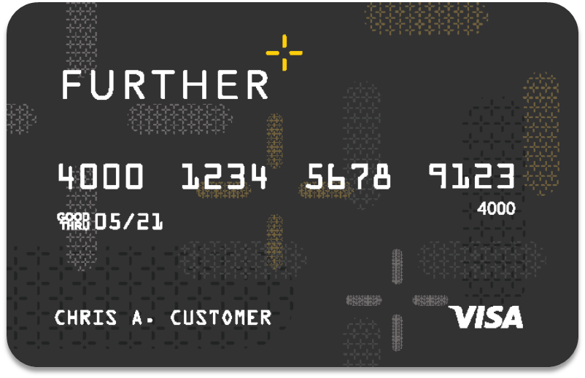
Further debit card
Can use for HSA, FSA, HRA and
VEBA purchases
A convenient way to pay for qualified purchases from your spending account(s)
Can be added to your digital wallet¹
Can order additional cards for spouse or dependent free of cost
Accepted anywhere VISA® is accepted
The debit card will come in a plain envelope – do not throw it away.
¹Digital payments not available on all accounts.

Slide 14

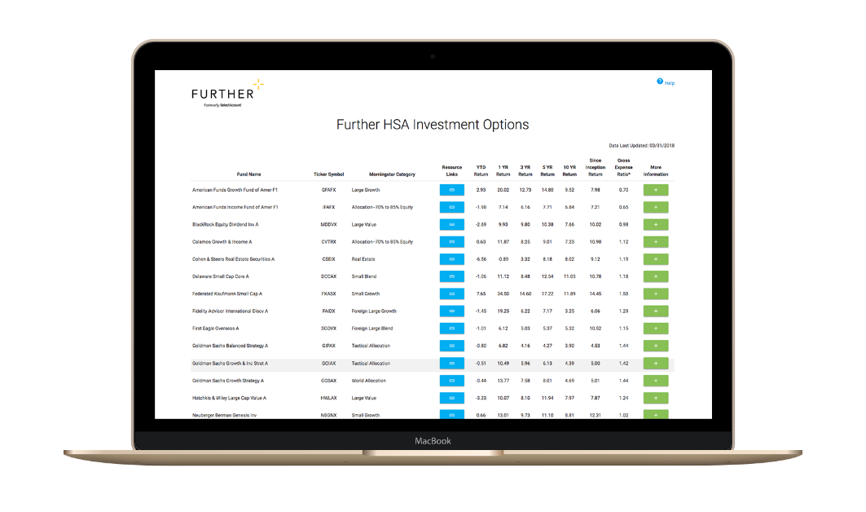
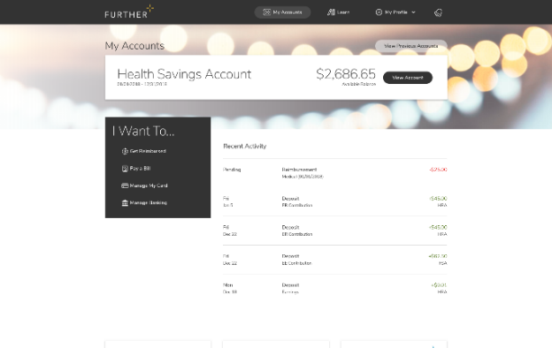

Learning Center
The Learning Center offers a robust array of articles, tools, and resources including:
  Savings calculators, videos and popular forms
  Guidance to help compare products
  Employer walkthrough of open-enrollment communication
  Tips for submitting claims
  Help using and managing your account
  Tax implication information
  How to get reimbursed
  FAQs
Designed to help you understand and maximize your health savings accounts

Slide 15


Let’s get started
Our expert service team is ready to help.
800-859-2144
M-F 7 AM - 8 pm CST
hellofurther.com
Notes:
Adjust times to the appropriate time zone in which you are presenting

