Slide 1
Invest in your health with a
Health Savings Account

Slide 2
Your Health Savings Account (HSA)
A financial account you own.
Expense account you own that works with your HSA-qualified health plan
Set aside a portion of pretax payroll
No taxes on money you put in or take out to pay for qualified medical expenses
Interest earned is tax-free
No “use it or lose it”; unused money rolls to next year
Always your money, even if you change jobs or retire
Can save 10% to 40% on medical care and treatment costs, depending on tax bracket¹
. ¹ Consult a tax advisor for more information

Slide 3
How your HSA works
Enroll in an HSA-qualified health plan
Ensure you are not:
A dependent on someone else’s taxes
Have no other health plan coverage
Not enrolled in Medicare
Set aside portion of payroll pretax, not more than:
$3,450 for single
$6,900 for family
Convenient SelectAccount debit card to pay providers
Submit bills for reimbursement for out-of-pocket

Slide 4
Meet Molly
Single professional, no children
Annual salary | $48,000
HSA contribution | $3,000
Taxable income | $45,000
Estimated tax rate¹ | 25%
¹ Assumes Molly pays 25% of her income in federal, State and social security taxes. Actual tax savings will depend on your HSA contributions, applicable State tax rates and your personal tax situation. Please consult your tax adviser for details.
Molly’s story is a hypothetical example for purposes of illustration only.

Slide 5
Molly’s savings
M | Without an HSA | With an HSA
Estimated taxes¹ | $12,000 | $11,250
Tax savings | $0 | $750
Health care expense | $600 | $600
HSA account | $0 | $600
HSA balance to roll over | $0 | $2,400
¹ Assumes Molly pays 25% of her income in federal, State and social security taxes. Actual tax savings will depend on your HSA contributions, applicable State tax rates and your personal tax situation. Please consult your tax adviser for details.
Molly’s story is a hypothetical example for purposes of illustration only.

Slide 6
Qualified HSA expenses
Expenses you can pay for:
These you can’t pay for:
Medical expenses that your health plan doesn’t cover:
Out-of-pocket
Co-pays, co-insurance
Prescription drugs
Health expenses not included in your health plan:
Dental and vision care
Costs not on the list of IRS-qualified expenses (see selectaccount.com)
Over-the-counter medicine
Non-prescription drugs
Supplements
Health insurance premiums
Always save your receipts to ensure proper validation of expenses, as required by the IRS.

Slide 7
Meet the Martinez’s
Maria and her teenage-son, Antonio
Annual salary | $68,000
HSA pre-tax contribution | $5,000
Net taxable income | $63,000
Estimated tax rate¹ | 25%
¹ Assumes that Maria pays 25% of her income in federal, State and social security taxes. Actual tax savings will depend on your HSA contributions, applicable State tax rates and your personal tax situation. Please consult your tax adviser for details.
The Martinez’ story is a hypothetical example for purposes of illustration only.

Slide 8
Maria’s savings
M | Without an HSA | With an HSA
Estimated taxes¹ | $17,000 | $15,750
Tax savings | $0 | $1,250
Health care expense | $2,450 | $2,450
HSA account pays medical expenses | $0 | $2,450
HSA balance rolls to next year | $0 | $2,550
¹ Assumes Maria pays 25% of her income in federal, State and social security taxes. Actual tax savings will depend on your HSA contributions, applicable State tax rates and your personal tax situation. Please consult your tax adviser for details.
The Martinez’ story is a hypothetical example for purposes of illustration only.
Notes:
HSA Case 2: Meet the Martinez’s
Maria is 41 and a manager at a small manufacturing business earning $68,000 per year. Her son, Antonio, is very involved in sports at his middle school. As a single parent, Maria is always looking for ways to save on health care costs and be ready for any unexpected costs that may not be covered by their health plan. As a way to curb rising health care premiums her employer only offers plans with high deductibles. Maria sees an HSA as a flexible way to help her manage their health care costs and save for medical expenses as Antonio enters high school.
Income $68,000
HSA Contribution $5,000 (pre-tax contribution)
Net Taxable Income $63,000
Tax @ 25% $15,750 (vs. $17,000 on $68K)
Tax Savings $1,250
Medical expense $2,450 (paid out of the HSA)
HSA Balance $2,550 (always carries over year after year)
In March, Antonio dislocates his shoulder pole vaulting in Track. His out-of-pocket medical expenses exceed the balance Maria has saved in her HSA by that time. However, since there is no time limit on when she can use money in her HSA to cover the cost, Maria is able to use the money she does have in the HSA to pay that portion of the bill, then pay the rest herself. Later, when she has enough saved in her account, she can reimburse herself for the portion she paid out-of-pocket.

Slide 9
Meet the Robinson’s
Two parent family with two school-age children
Combined annual salary | $94,000
HSA pre-tax contribution (2018 limit) | $6,900
Net taxable income | $87,100
Estimated tax rate¹ | 25%

Slide 10
The Robinson’s savings
M | Without an HSA | With an HSA
Estimated taxes¹ | $23,500 | $21,775
Tax savings | $0 | $1,725
Health care expense | $1,850 | $1,850
HSA account pays medical expenses | $0 | $1,850
HSA balance rolls to next year | $0 | $3,150
¹ Assumes the Robinson’s pay 25% of their income in federal, State and social security taxes. Actual tax savings will depend on your HSA contributions, applicable State tax rates and your personal tax situation. Please consult your tax adviser for details.
The Robinson’s story is a hypothetical example for purposes of illustration only.
Notes:
HSA Case 3: Meet the Robinsons.
Isiah and Michelle have a growing family with two school-age children. Isiah works for a large manufacturing company as a manager making $56,000. Michelle runs her own catering business from home and makes $38,000. Isiah’s employer offered an HSA-qualified health plan this year that allows him to set aside up to $6,900 tax-free to pay for annual deductibles, save for dental and vision expenses and be prepared for any unplanned medical costs that may come up. The Robinsons decide to contribute $5,000 because they know any amount contributed and any interest it may earn is tax-free and remains theirs from year-to-year for qualified expenses. And, because their balance is above $1000, they take advantage of the more than 30 investment options available through Charles Schwab, anticipating their balance will increase each year.
Income $94,000
HSA Contribution $6,900 (pre-tax contribution – the max for 2018)
Net Taxable Income $87,100
Tax @ 25% $21,775 (vs. 23,500 on $94K)
Tax Savings $1,725.00
Medical expenses $1,850 (paid out of the HSA)
HSA Balance $3,150

Slide 11
Meet the Schwartz’s
Empty nesters – Bill and Emily, retiring in 5 yrs.
Combined annual salary | $125,000
HSA pre-tax contribution (2018 limit) | $6,900
HSA catch-up contribution | $1,000
Net taxable income | $117,100
Estimated tax rate¹ | 25%
¹ Assumes that the Schwartz’s pay 25% of their income in federal, State and social security taxes. Actual tax savings will depend on your HSA contributions, applicable State tax rates and your personal tax situation. Please consult your tax adviser for details.
The Schwartz’s story is a hypothetical example for purposes of illustration only.

Slide 12
The Schwartz’s savings
M | Without an HSA | With an HSA
Estimated taxes¹ | $31,250 | $29,275
Tax savings | $0 | $1,975
Health care expense | $1,400 | $1,400
HSA account pays medical expenses | $0 | $1,400
HSA balance rolls to next year | $0 | $6,500
Invested in mutual funds² | $0 | $5,000
¹ Assumes the Schwartz’s pay 25% of their income in federal, State and social security taxes. Actual tax savings will depend on your HSA contributions, applicable State tax rates and your personal tax situation. Please consult your tax adviser for details.
² Balances over $1,000 are eligible to invest in more 30 mutual fund options through Charles Schwab.
The Robinson’s story is a hypothetical example for purposes of illustration only.
Notes:
HSA Case 4: Meet the Schwartz’s.
Bill and Emily Schwartz are 58 and healthy empty nesters. With their children on their own, Bill is looking ahead to retiring from his corporate job in five years where he earns a salary of $98,000. Emily is a free-lance web designer whose services are increasingly in demand. She made $27,000 just starting out, with increased opportunities to double that next year. They want to maximize their retirement savings by taking advantage of the extra contribution available for people 55 years and older. That way they can plan for medical expenses that may not be covered once they are on Medicare.
Income $125,000
HSA Contribution $ 6,900 (pre-tax contribution)
Extra contribution $ 1,000 (pre-tax contribution)
Net Taxable Income $117,100
Tax @ 2% $ 29,275 (vs. $31,250 on $125K)
Tax Savings $1,975.00
Medical expenses $1,400.00 (paid out of the HSA/VEBA)
HSA Balance $6,500 carries over to next year and can be invested

Slide 13
Investment Options
$10,000+
$1,000-10,000+
$1,000+
$1,000 minimum
Basic Investment Account
Self-directed brokerage account
$0-$1,000
A minimum of $1,000 required in your HSA Base Balance

Slide 14
More than 30 mutual funds
Updated quarterly

Slide 15
Quarterly investment statement
Review activity
Manage asset allocation
View fund performance

Slide 16
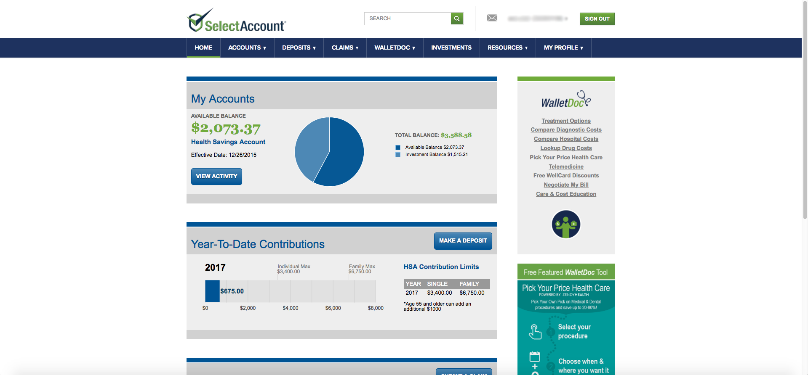
Next steps after you’re enrolled
Receive your SelectAccount I.D. and debit card by mail
Use it to register at SelectAccount.com and get the mobile app
Use your Visa© debit card to pay providers.

Slide 17
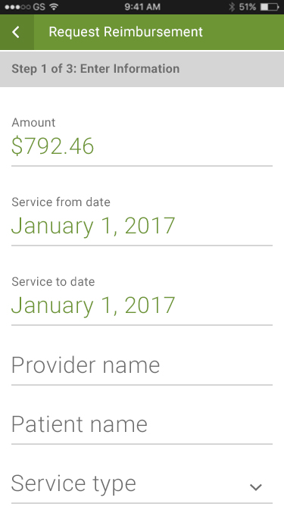
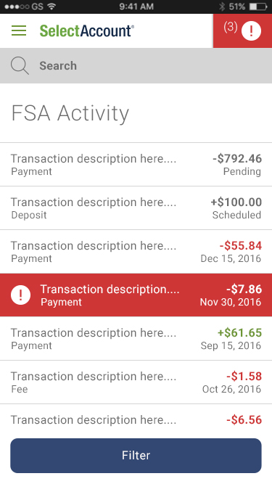
Manage your account on the new mobile app
View account activity and check balances
Get forms and upload receipts
Request additional debit cards
View and manage investments over $1,000

Slide 18
800-859-2144
Monday thru Friday 7 a.m. to 8 p.m. CST
Let’s get started
Our expert service team is ready to help.
SelectAccount.com
Notes:
Adjust times to the appropriate time zone in which you are presenting

Slide 19
Thank you!

