Slide 1
Invest in your health with a
Flexible Spending Account

Slide 2
Your Medical Flexible Spending Account (FSA)
Making it easier to manage health care
Expense account that works with your health plan
Set aside a portion of pretax payroll
Pay qualified medical costs, tax-free
Save 10% to 40% on medical care and treatment costs, depending on tax bracket¹
¹ Depends on your income tax bracket. Consult a tax advisor for more information.

Slide 3
How your FSA works
Estimate next year’s out-of-pocket costs
Equal portions deposited from your paycheck
Total amount is available day one
Estimate only what you think you will use.¹
A spouse in another plan may also open an FSA
Each account up to $2,600 limit
Convenient FSA debit card to pay providers
1 Depending on how your employer sets up the account, money may be forfeited at the end of the plan year or grace period

Slide 4
Meet Susan
Single parent with 1 child
Annual salary | $58,000
FSA maximum contribution | $2,600
Taxable income | $55,400
Estimated tax rate¹ | 25%
¹ Assumes Susan pays 25% of her income in federal, State and social security taxes. Actual tax savings will depend on your contributions, applicable State tax rates and your personal tax situation. Please consult your tax adviser for details.
The Susan’s story is a hypothetical example for purposes of illustration only.

Slide 5
Susan’s savings
M | Without an FSA | With an FSA
Medical FSA contribution | $0 | $2,600
Susan’s estimated taxes¹ | $14,500 | $13,850
Health care expenses | $2,600 | $2,600
FSA | $0 | $2,600
Tax savings | $0 | $650
Net disposable income | $40,900 | $41,550
¹ Assumes Susan pays 25% of her income in federal, State and social security taxes. Actual tax savings will depend on your contributions, applicable State tax rates and your personal tax situation. Please consult your tax adviser for details.
Susan’s story is a hypothetical example for purposes of illustration only.

Slide 6
Qualified medical FSA expenses
Expenses you can pay for:
These you can’t pay for:
Medical treatment or care
Costs not covered by health plan:
Out-of-pocket
Co-pays, co-insurance
Prescription drugs
Health expenses not included in your health plan:
Dental and vision care
Expenses not related to medical treatment or care
Over-the-counter medicine
Non-prescription drugs
Supplements
Health insurance premiums
Always save your receipts to ensure proper validation of expenses, as required by the IRS.

Slide 7
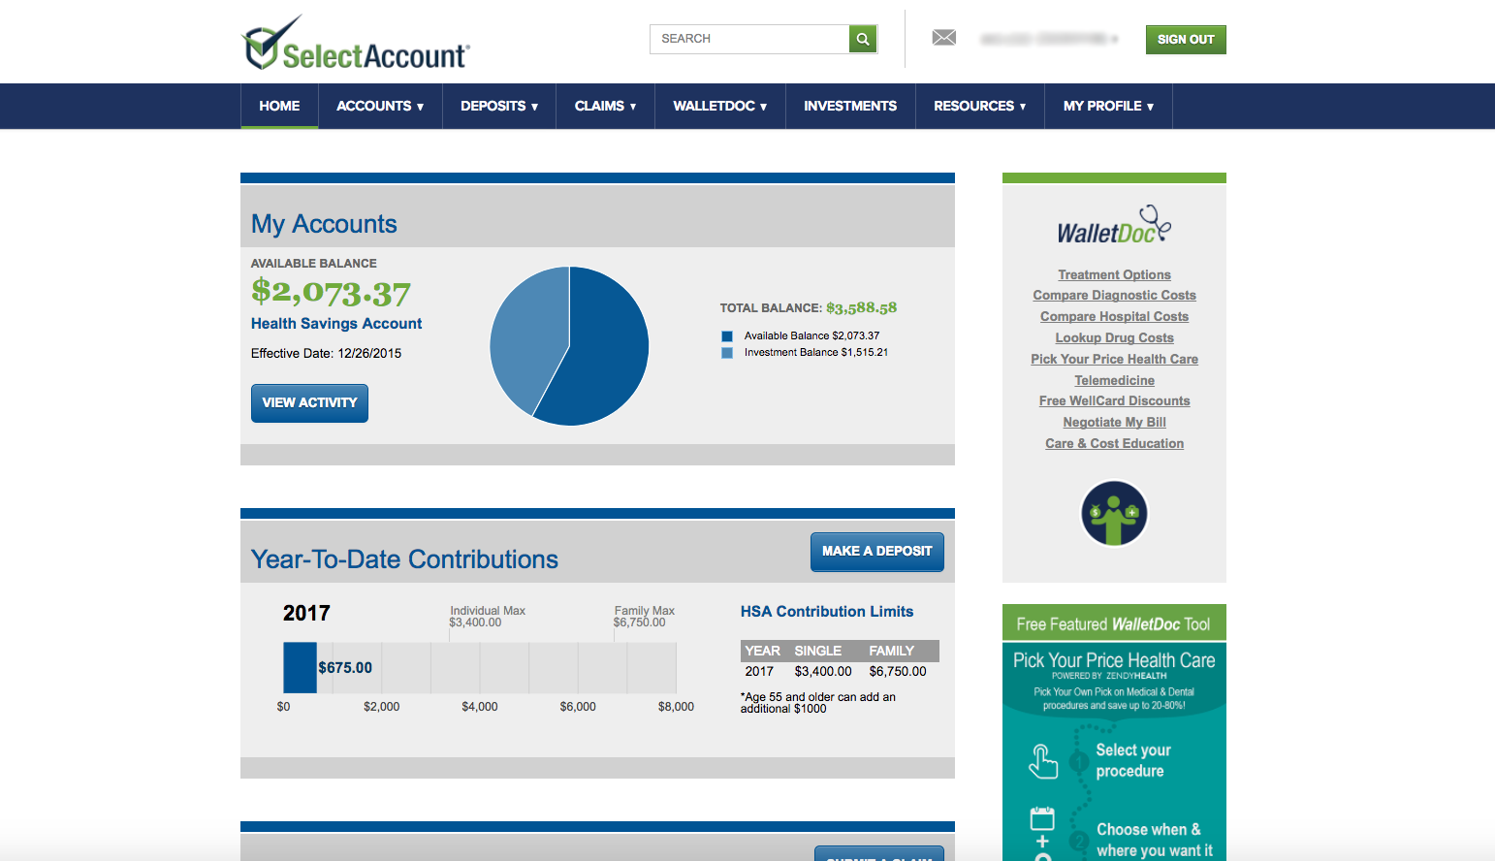
After you’re enrolled
Receive your SelectAccount I.D. by mail
Register at SelectAccount.com
Receive your debit card by mail
Get the mobile app
Pay providers with your debit card or submit claims for reimbursement

Slide 8
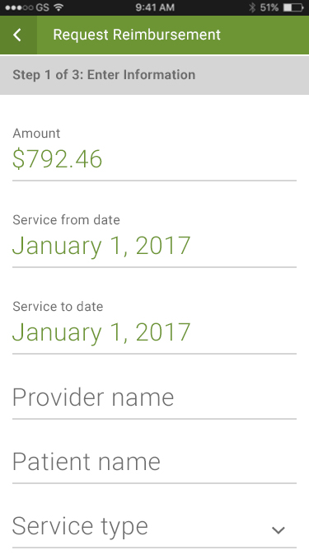
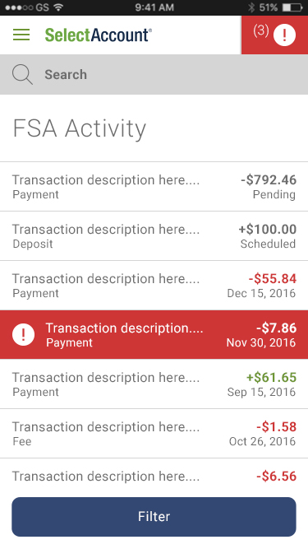
Manage your FSA at SelectAccount.com
View account activity and check balances
Download forms and upload receipts
Request additional debit cards

Slide 9
800-859-2144
Monday thru Friday 7 a.m. to 8 p.m. CST
Let’s get started
Our expert service team is ready to help.
SelectAccount.com
Notes:
Adjust times to the appropriate time zone in which you are presenting

Slide 10
Thank You!

