Slide 1
Investment options for your
Health Savings Account

Slide 2
Investment Options
$10,000+
$1,000-10,000+
$1,000+
$1,000 minimum
Basic Investment Account
Self-directed brokerage account
$0-$1,000
A minimum of $1,000 required in your HSA Base Balance

Slide 3
More than 30 mutual funds
Updated quarterly

Slide 4
Quarterly statement
Reviews activity
Shows asset allocation and performance by class

Slide 5
Getting started
Your SelectAccount ID sent in your Welcome Kit
Register your account
Call SelectAccount customer service for assistance @ 800-859-2144

Slide 6
Meet the Schwartz’s
Empty nesters – Bill and Emily, retiring in 5 years
Combined annual salary | $125,000
HSA pre-tax contribution (2018 limit) | $6,900
HSA catch-up contribution | $1,000
Net taxable income | $117,100
Estimated tax rate¹ | 25%
¹ Assumes that the Schwartz’s pay 25% of their income in federal, State and social security taxes. Actual tax savings will depend on your HSA contributions, applicable State tax rates and your personal tax situation. Please consult your tax adviser for details.
The Schwartz’s story is a hypothetical example for purposes of illustration only.

Slide 7
The Schwartz’s savings
M | Without an HSA | With an HSA
Estimated taxes¹ | $31,250 | $29,275
Tax savings | $0 | $1,975
Health care expense | $1,400 | $1,400
HSA account pays medical expenses | $0 | $1,400
HSA balance rolls to next year | $0 | $6,500
Invested in mutual funds² | $0 | $5,000
¹ Assumes the Schwartz’s pay 25% of their income in federal, State and social security taxes. Actual tax savings will depend on your HSA contributions, applicable State tax rates and your personal tax situation. Please consult your tax adviser for details.
² Balances over $1,000 are eligible to invest in more 30 mutual fund options through Charles Schwab.
The Robinson’s story is a hypothetical example for purposes of illustration only.
Notes:
HSA Case 4: Meet the Schwartz’s.
Bill and Emily Schwartz are 58 and healthy empty nesters. With their children on their own, Bill is looking ahead to retiring from his corporate job in five years where he earns a salary of $98,000. Emily is a free-lance web designer whose services are increasingly in demand. She made $27,000 just starting out, with increased opportunities to double that next year. They want to maximize their retirement savings by taking advantage of the extra contribution available for people 55 years and older. That way they can plan for medical expenses that may not be covered once they are on Medicare.
Income $125,000
HSA Contribution $ 6,900 (pre-tax contribution)
Extra contribution $ 1,000 (pre-tax contribution)
Net Taxable Income $117,100
Tax @ 2% $ 29,275 (vs. $31,250 on $125K)
Tax Savings $1,975.00
Medical expenses $1,400.00 (paid out of the HSA/VEBA)
HSA Balance $6,500 carries over to next year and can be invested

Slide 8
Self-managed through member portal
Basic Investment account:
HSA Base Balance exceeds $1000
$1.50 monthly fee
More 30 mutual funds available
Brokerage account:
Available balance exceeds $10,000
$1.50 monthly fee
Managed through Charles Schwab.com
Access to full Schwab brokerage investments
.

Slide 9
Transferring funds
Select ‘Request a Transfer’ button and proceed

Slide 10
Selecting the amount
Step 1
Review ‘Amount Available to Transfer’. This reflects the available balance >$1000.
Enter amount into ‘Amount to Transfer to Your Basic Investment Account’.
Select Next

Slide 11
Confirm the transfer
Step 2
Review your transfer amount.
Click the box next to ‘I understand funds…’
Select Submit
Please allow three business days for your changes to be reflected on your account.

Slide 12
Re-align Investments
Future Investments:
Step 1- Review Current % by Investment
Step 2- Choose investment(s) and New %. Add as many as you wish until 100% allocated
Step 3- Submit Investment Elections
Realignment:
Step 1 - Review Current % by Investment
Step 2 - Choose investment(s) and New %. Add as many as you wish until 100% allocated.
Step 3- Submit Realignment

Slide 13
Transfer to Base Balance
Scroll over ‘Plan Services’ and select ‘Transfer to Base Balance’
Step 1 - Enter Transfer Amount
Step 2 - Reason and Transfer Method changed to ‘Transfer to Base Account
Step 3- Submit Request
Review and click ‘I accept’

Slide 14
Transferring between Funds
Scroll over ‘Plan Services’ and select ‘Transfer Investments’
Step 1 - Choose Transfer type
Step 2 - Choose Funds/Balances and
appropriate Investment
Step 3 - Choose Transfer Amount
Step 4 - Click Continue
Step 5 - Review and Accept

Slide 15
Transfer tips
Transfer funds out when you need them
When you want to:
Pay health care expenses
No longer invest in Funds
No Service Fees to transfer
No minimum balance transfer request
Funds arrive within 2-3 business days
Transfer funds between two or more mutual funds
Allows for $ to $, $ to % or % to % transfers
No minimum balance transfer request
Transfer occurs in 2-3 business days

Slide 16
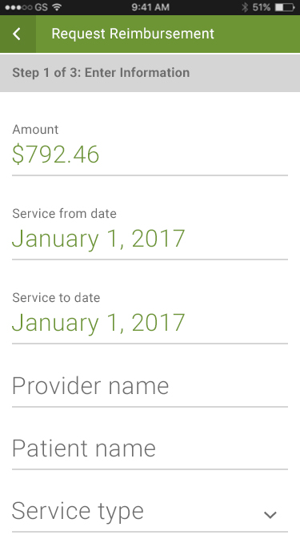
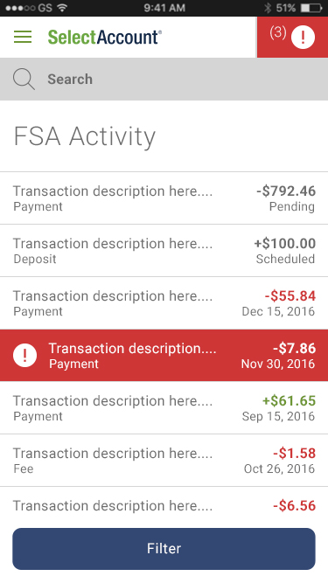
Our expert service team is ready to help
Certified Medical Banking Specialists ready to answer your questions
100% call recording and documentation
Customer satisfaction surveys

Slide 17
Manage your account at SelectAccount.com
View account activity and check balances
Review the list of investment options
Monitor Fund performance
Move and manage assets

Slide 18
800-859-2144
Monday thru Friday 7 a.m. to 8 p.m. CST
Let’s get started
SelectAccount.com
Notes:
Adjust times to the appropriate time zone in which you are presenting

Slide 19
Thank You!

