Slide 1
Your Dependent Care
Flexible Spending Account

Slide 2
Your Dependent Care Flexible Spending Account (FSA)
Making it easier to manage dependent care costs while you work.
Expense reimbursement account for paying qualified dependent care costs, tax-free
Set aside a portion of pretax payroll
Save 10% to 40% on these costs, depending on tax bracket¹
¹ Depends on your income tax bracket. Consult a tax advisor for more information.

Slide 3
How your Dependent Care FSA works
Estimate next year’s eligible dependent care costs
Equal portions deposited from your paycheck pretax – your money is available when deposited
Estimate only what you think you will use.¹
A spouse in another plan may also open an FSA
Your combined contribution can’t be more than the $5,000 limit
Submit claims for reimbursement – online or by faxing
1 Depending on how your employer sets up the account, money may be forfeited at end of the plan year or grace period

Slide 4
Meet Susan
Single parent, one child
Annual salary | $58,000
FSA maximum contribution | $5,000
Taxable income | $53,000
Estimated tax rate¹ | 25%
¹ Assumes Susan pays 25% of her income in federal, State and social security taxes. Actual tax savings will depend on your contributions, applicable State tax rates and your personal tax situation. Please consult your tax adviser for details.
Susan’s story is a hypothetical example for purposes of illustration only.

Slide 5
Susan’s dependent care savings
 | Without an FSA | With an FSA
Dependent care contribution | $0 | $5,000
Estimated taxes¹ | $14,500 | $13,250
Dependent care expenses | $5,000 | $5,000
FSA | $0 | $5,000
Tax savings | $0 | $1,250
Net disposable income | $38,500 | $39,750
¹ Assumes Susan pays 25% of her income in federal, State and social security taxes. Actual tax savings will depend on your contributions, applicable State tax rates and your personal tax situation. Please consult your tax adviser for details.
Susan’s story is a hypothetical example for purposes of illustration only.

Slide 6
Qualified Expenses
For your FSA to work, you can pay for:
These you can’t pay for:
Licensed day care facilities
Licensed pre-school and after-school programs
In-home care services
Elder care
Special day camp expenses
Kindergarten or school tuition
School lunches and food items
School activity fees
Overnight camp
Always save your receipts to ensure proper validation of expenses, as required by the IRS.

Slide 7
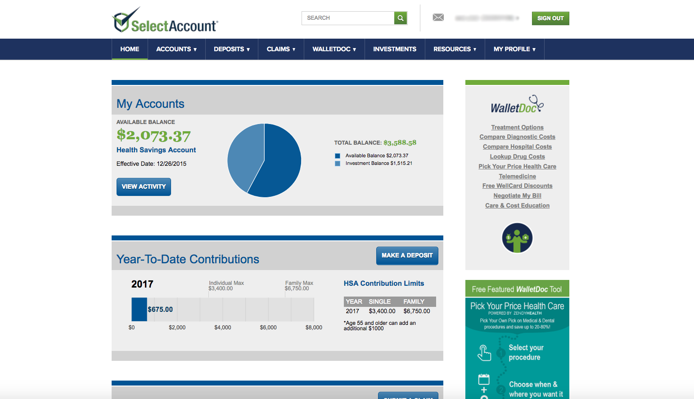
After you’re enrolled
Receive your SelectAccount I.D. by mail
Register at SelectAccount.com
Get the mobile app
Pay providers and submit claims for reimbursement

Slide 8
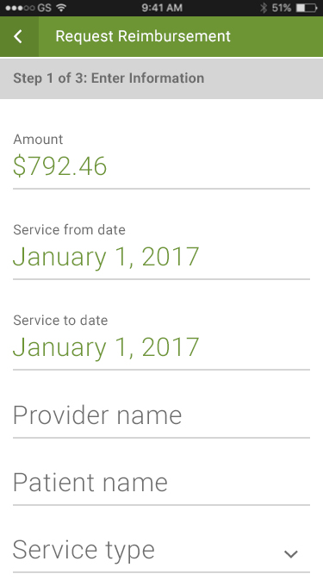
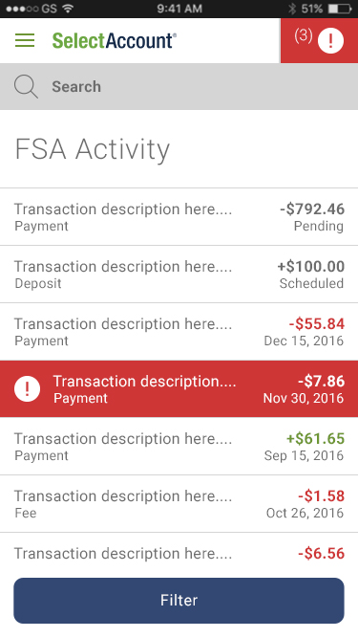
Manage your FSA at SelectAccount.com
View account activity and check balances
Submit receipts and claims for reimbursement
Download forms and upload receipts

Slide 9
800-859-2144
Monday thru Friday 7 a.m. to 8 p.m. CST
Let’s get started
Our expert service team is ready to help.
SelectAccount.com
Notes:
Adjust times to the appropriate time zone in which you are presenting

Slide 10
Thank You!

